Slide 1
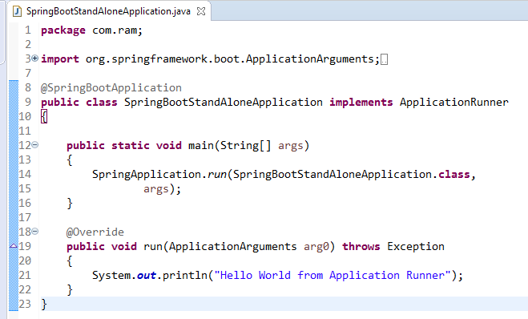
Spring Boot – Runners [Application Runner]
Application Runner is an interface used to execute the code after the Spring Boot application started.

